Slide 1
PCFG Next Function Overview
password123
Password12
1
2
3
4
5
123456
monkey13
piano1812

Slide 2

Terms
PCFG = Probabilistic Context Free Grammar
Probabilistic: Every transition has a probability associated with it
Context Free: Individual transitions do not impact each other
Normally this is desired since in passwords the base word often is independent of the other mangling
E.g. ‘Monkey’ + ‘123’
Sometimes you want to add context though. For example, create a password guess 7 characters long. There are ways to design a PCFG to model those requirements and add some “context” if desired.
Grammar: This is a model. Much like how a sentence can be constructed, so can a password

Slide 3

Assumptions
The transitions in the grammar are non-ambiguous
By this, no transitions share the same replacement
E.g.: Not allowed: Trans1 -> ReplacementA, Trans2 -> ReplacementA
Disclaimer: In reality, the grammar is ambiguous due to features like representing keyboard walks. For purposes of discussing the “next” algorithm though, we’re going to ignore those
The grammar does not contain recursion
There are no loops
E.g.: Not allowed: Trans1 -> Trans2 -> Trans1
Disclaimer: Support for recursion was actually included in the PCFGv3 implementation. It adds a lot of complexity, and recursion was never made use of in the password grammar, so for this this guide we’re going to ignore it

Slide 4
More Assumptions
When multiple transitions occur before a final terminal (excluding the first transition from ‘S’), following transition type occurs universally to the previous transition
This is a huge restriction, and made to simplify implementation of the ‘next’ function
Think case-mangling. S->[‘cat’,’dog’,’rat’]. Now you want to apply case mangling to those alpha strings. It’s easier to represent it as a mask
E.g. S->[‘cat’,’dog’,’sam’’] x [‘LLL’,’ULL’,’UUU’]
This can formally be represented in a traditional PCFG as ‘cat’ -> [‘cat’,’Cat’,CAT’], but it allows for optimizations

Slide 5
General Documentation Conventions
A PCFG transition will be represented by a capital letter
Example: ‘A’
Transitions are followed by a subscript of the current replacement ordered by probability
Example: ‘A₁’ for the most probable, ‘A₂’ for the second most probable…
Multiple transitions representing a parse tree can be represented as a string
Example: ‘A₅B₁C₂’ could potentially represent ‘cat123$’
Based on Assumption #3, transitions are expanded out
Example: For case mangling A₁B₂ could represent the most common word, with the second most common case mangling mask applied to it

Slide 6

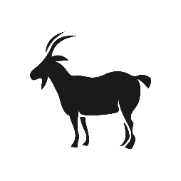
Desired Goals of the ‘Next’ Algorithm
Only generate a parse tree once
Avoid duplicates
Generate parse tress in probability order
Start with the most probable parse, then the second most probable, etc.
Minimize memory and running time requirements
“Achieving all three goals is an open problem”

Slide 7
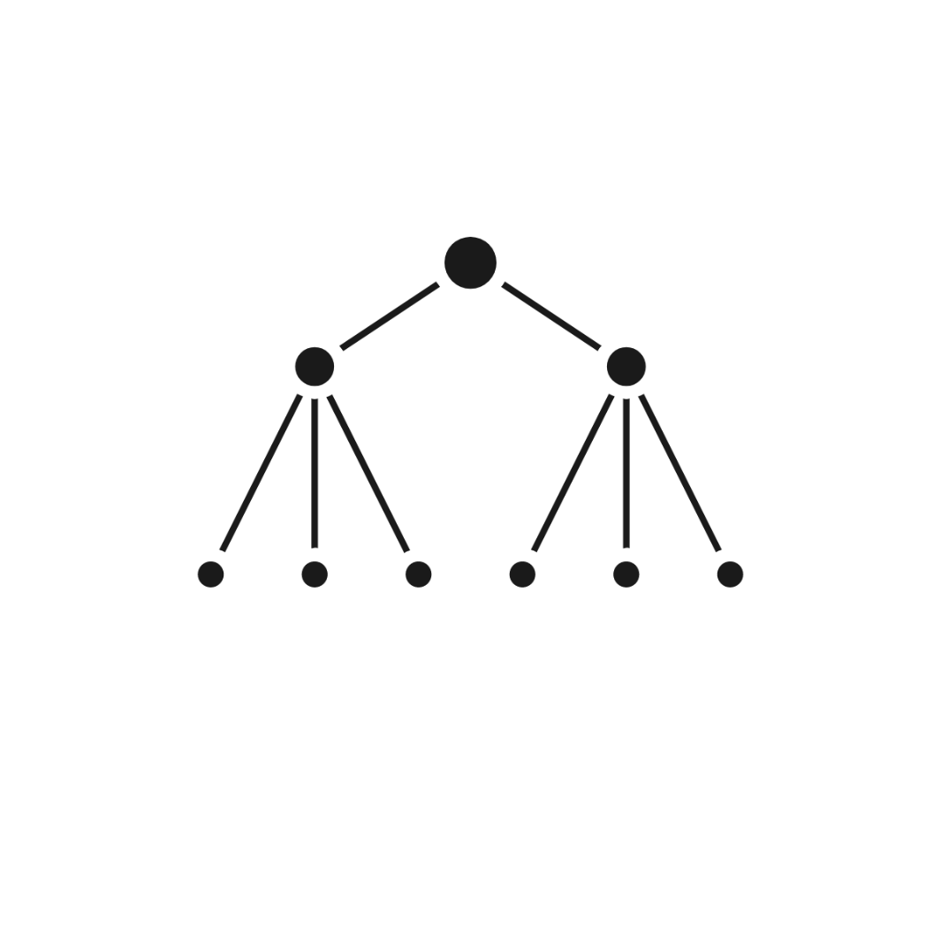


Current Approaches:
Turn the PCFG into a tree search problem
Then can apply traditional search techniques like DFS, BFS, etc.

Slide 8

Challenge with Tree Search
A PCFG is not a Tree
Technically it can be represented with a Directed Acyclic Graph (DAG)
PCFG

Slide 9
Challenge Mapping out PCFG Parse Trees as Trees
 |  |  |  |  | A₁B₁C₁
 | A₂B₁C₁ |  |  |  | A₁B₂C₁ |  |  |  | A₁B₁C₂
A₃B₁C₁ | A₂B₂C₁ | A₂B₁C₂ |  | A₂B₂C₁ | A₁B₃C₁ | A₁B₂C₂ |  | A₂B₁C₂ | A₁B₂C₂ | A₁B₁C₃
Duplicates
……………………..
Duplicates
Duplicates

Slide 10
PCFG v1.0 Next Algorithm
Include a ‘pivot’ value with each child where it can only create children at the ‘pivot’ value or greater
Results in very lopsided looking trees that do not contain duplicates
 |  |  |  |  | A₁B₁C₁
 | A₂B₁C₁ |  |  |  | A₁B₂C₁ |  |  |  | A₁B₁C₂
A₃B₁C₁ | A₂B₂C₁ | A₂B₁C₂ |  |  | A₁B₃C₁ | A₁B₂C₂ |  |  |  | A₁B₁C₃

Slide 11
Applying Breath First Search
Use a Priority Queue (PQ) that holds all of the leaf nodes
When you pop the top node off the PQ, it will be the most probable item to generate guesses with
Then push back into the PQ all of the popped item’s child nodes
The PQ will hold all the leaf nodes of the current progress of the BFS
 |  |  |  |  | A₁B₁C₁
 | A₂B₁C₁ |  |  |  | A₁B₂C₁ |  |  |  | A₁B₁C₂
A₃B₁C₁ | A₂B₂C₁ | A₂B₁C₂ |  |  | A₁B₃C₁ | A₁B₂C₂ |  |  |  | A₁B₁C₃

Slide 12
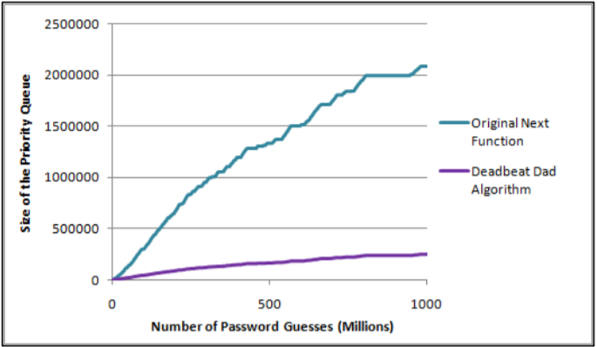
Problems with the Original Next Function
It is extremely memory intensive
While only one parent will generate a child node, many potential parents may still be in the PQ when the child node is generated
This causes the PQ to quickly becomes bloated
As comparison, the following graph shows the memory usage of the original PCFG v1.0 function and the “next” function used in following versions

Slide 13
Deadbeat Dad “Next” Algorithm
Unfortunate name, I know. It was created after spending way too much time talking about having parent nodes abandon their children for other parents to take care of.
In a nutshell, it still uses a PQ, and still pops off the most probable node and then inserts children of that node back into the PQ
The difference is in how children of a node are determined
Takes advantage of the fact that a child node’s probability will always be less than or equal to its least probable parent. Therefore we shouldn’t insert a child node until all of its parents have been popped.

Slide 14
Parent Selection for DD “Next” Algorithm
Generate all possible children for each node popped from the PQ
For each potential child, generate all of its other parents
If any of the parents have a lower probability than the popped node, discard the child node and let the lowest probability parent take care of it
This relies on the fact that a child will always have equal or lower probability than all of its parents, so it should not generate guesses until after its parents
We don’t want to push a child into the PQ until the last parent has been popped
In the event of a tie between the lowest probability parents, the parent with the rightmost transition to generate the child is assigned ownership of the child
- This is arbitrary, but we need a tiebreaker in this edge case

Slide 15
Problems with the DD “Next” Algorithm
It’s computationally expensive, slowing down guess generation
Over longer cracking periods, the PQ still grows to an unacceptable level, requiring other memory management techniques to be applied

Slide 16
Possible Improvements to BFS
There’s been a lot of research into better BFS algorithms in the last ten years since the v2 “next” algorithm was written
There’s some promising approaches beyond using a PQ
Lots of improvements are possible, but memory management is still a running concern for alternate BFS implementations that I’ve looked at
Long story short, this is a problem that I keep expecting to have been solved in other contexts,
Either in general tree BFS, DAG BFS, or PCFG BFS
Memory management is a killer. Most “AI” solvers I’ve looked at tend to use a combination of Depth First Search (DFS) and BFS to compensate
Open research problem!

Slide 17


Other Approaches

Slide 18
Dropping the “Probability Order” Requirement
If you no longer care about generating guesses in true probability order, there are multitude of *much* faster “next” algorithms you can use.
Basically you are no longer using BFS. Other approaches can be using DFS which has very limited memory and computational requirements.
This can be seen in John the Ripper’s –Markov mode

Slide 19
Dropping “Probabilities” too!!!
Rather than calculate the true probability of each PCFG terminal, you can quantize each transition and use addition + limits, much like OMEN and JtR’s –Markov does as well.
Now you are doing addition of INTs, vs. multiplication of FLOATs, which speeds things up.
In fact, PCFGs can use the underlying algorithm in OMEN with very little modification. Instead of length, choose a base structure as a starting point.
Since the CF in PCFG stands for “context free” this allows for even more optimizations than other Markov based approaches

Slide 20
In Conclusion
There’s a lot of ways to generate guesses with Context Free Grammars
The speed/memory trade-offs occur when specifying requirements for generating probable guesses first
Most other current guessing algorithms can be adapted to use Context Free Grammars if desired
Feel free to think outside the box. Don’t let current implementations that utilize pqueues and large memory requirements limit your thinking!

